Slide 1
Computer Networks
“DATA LINK LAYER - 2”
Asst. Lect. Ahmed M. Jasim
Computer Department - College of Engineering
University of Diyala
2017

Slide 2
ERROR DETECTION AND CORRECTION
Types of Errors
A- Single-bit error
Only 1 bit of a given data unit is changed from 1 to 0 or from 0 to 1.
Single bit errors are least likely type of errors in serial data transmission.
Single-bit error can happen if we are having a parallel data transmission.

Slide 3
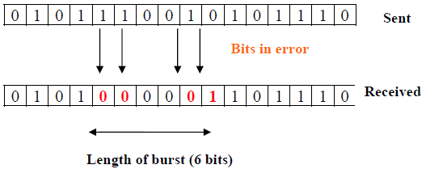
ERROR DETECTION AND CORRECTION
B- Burst error:
Two or more bits in the data unit have changed from 0 to 1 or vice-versa.
Burst errors are mostly likely to happen in serial transmission.

Slide 4
ERROR DETECTION AND CORRECTION
Redundancy
The central concept in detecting or correcting errors is redundancy.
To be able to detect or correct errors, we need to send some extra bits with our data.
These redundant bits are added by the sender and removed by the receiver.
This technique is called redundancy because the extra bits are redundant to the information.

Slide 5
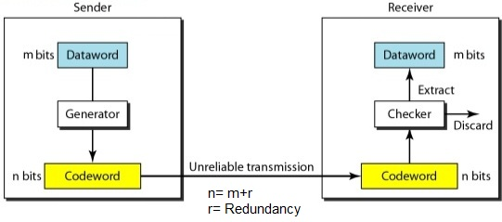
ERROR DETECTION AND CORRECTION

Slide 6
ERROR DETECTION AND CORRECTION
Error Detecting Codes
Basic approach used for error detection is the use of redundancy.
Popular techniques are:
Simple Parity check
Two-dimensional Parity check
Checksum
Cyclic redundancy check

Slide 7
ERROR DETECTION AND CORRECTION
A- Simple Parity Checking or One-dimension Parity Check
The most common and least expensive mechanism.
In this technique, a redundant bit called parity bit, is appended to every data unit so that the number of 1s in the unit (including the parity becomes even).
It is also possible to use odd-parity checking, where the number of 1’s should be odd.

Slide 8
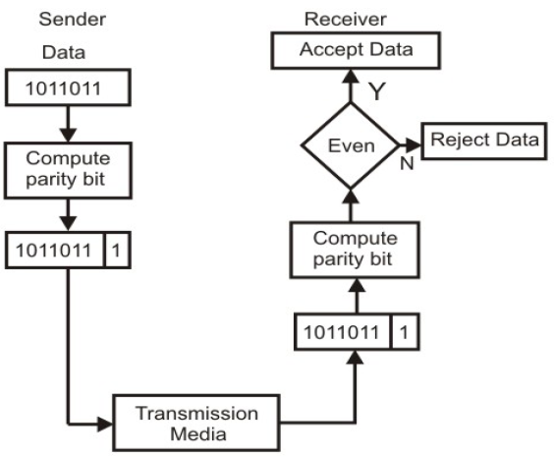
ERROR DETECTION AND CORRECTION

Slide 9
ERROR DETECTION AND CORRECTION
Decimal value | Data Block | Parity bit | Code word
0 | 0000 | 0 | 00000
1 | 0001 | 1 | 00011
2 | 0010 | 1 | 00101
3 | 0011 | 0 | 00110
4 | 0100 | 1 | 01001
5 | 0101 | 0 | 01010
6 | 0110 | 0 | 01100
7 | 0111 | 1 | 01111
8 | 1000 | 1 | 10001
9 | 1001 | 0 | 10010
10 | 1010 | 0 | 10100
11 | 1011 | 1 | 10111
12 | 1100 | 0 | 11000
13 | 1101 | 1 | 11011
14 | 1110 | 1 | 11101
15 | 1111 | 0 | 11110

Slide 10
ERROR DETECTION AND CORRECTION
Performance
Errors in more than one bit cannot be detected.
It can be shown that a single parity check code can detect only odd number of errors in a code word.

Slide 11
ERROR DETECTION AND CORRECTION
B- Two-dimension Parity Check
Organizes the block of bits in the form of a table.
Parity check bits are calculated for each row, which is equivalent to a simple parity check bit.
Parity check bits are also calculated for all columns then both are sent along with the data.
At the receiving end these are compared with the parity bits calculated on the received data.

Slide 12
ERROR DETECTION AND CORRECTION

Slide 13
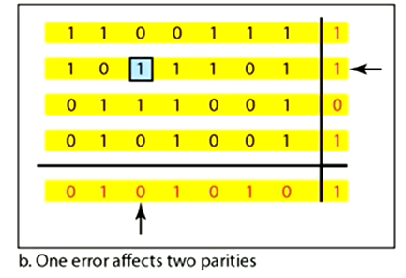
ERROR DETECTION AND CORRECTION
Performance
Two- Dimension Parity Checking increases the likelihood of detecting burst errors.

Slide 14
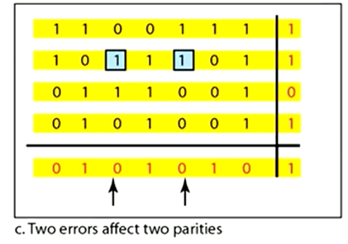
ERROR DETECTION AND CORRECTION

Slide 15
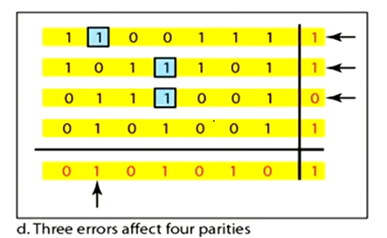
ERROR DETECTION AND CORRECTION

Slide 16
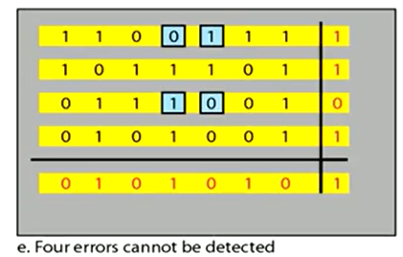
ERROR DETECTION AND CORRECTION
If two bits in one data unit are damaged and two bits in exactly same position in another data unit are also damaged, the 2-D Parity check checker will not detect an error as shown in figure e.

Slide 17
ERROR DETECTION AND CORRECTION
C- Checksum
In checksum error detection scheme, the data is divided into k segments each of m bits.
In the sender’s end the segments are added using 1’s complement arithmetic to get the sum. The sum is complemented to get the checksum.
The checksum segment is sent along with the data segments as shown in example:

Slide 18
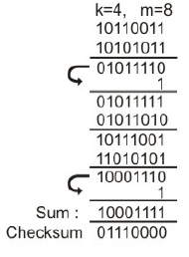
ERROR DETECTION AND CORRECTION
Example: Suppose the following block of 32 bit is to be sent using a checksum of 8 bit: 10110011 10101011 01011010 11010101
The pattern sent is: 10110011 10101011 01011010 11010101 01110000

Slide 19
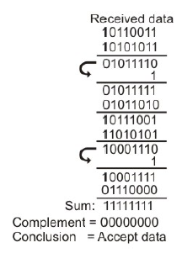
ERROR DETECTION AND CORRECTION
At the receiver’s end, all received segments are added using 1’s complement arithmetic to get the sum. The sum is complemented. If the result is zero, the received data is accepted; otherwise discarded, as shown below:
Performance
The checksum detects all errors involving an odd number of bits. It also detects most errors involving even number of bits.

Slide 20
ERROR DETECTION AND CORRECTION
D- Cyclic Redundancy Checks (CRC)
The most powerful and easy to implement technique.
Unlike checksum scheme, which is based on addition, CRC is based on binary division.
In CRC, a sequence of redundant bits, called cyclic redundancy check bits.
At the destination, the incoming data unit is divided by the same number. If at this step there is no remainder, the data unit is assumed to be correct and is therefore accepted.
A remainder indicates that the data unit has been damaged in transit and therefore must be rejected.

Slide 21
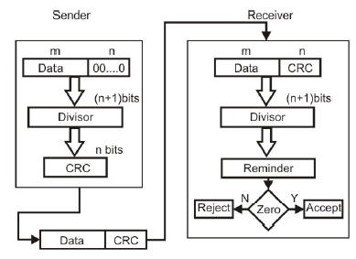
ERROR DETECTION AND CORRECTION

Slide 22
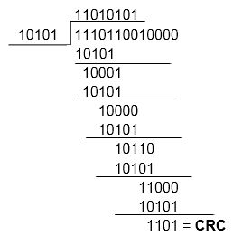
ERROR DETECTION AND CORRECTION
Example: Obtain the 4-bit CRC code word for the data bit sequence 111011001 using the generator 10101?
Transmitted frame: 1110110011101

Slide 23
ERROR DETECTION AND CORRECTION
The CRC is also known as a polynomial code.
Polynomial codes are based upon treating bit strings as representations of polynomials with coefficients of 0 and 1 only.
A k-bit frame is regarded as the coefficient list for a polynomial with k terms, ranging from
For example:110001 has 6 bits and thus represents a six-term polynomial with coefficients 1, 1, 0, 0, 0, and 1:

Slide 24
ERROR DETECTION AND CORRECTION
Error Correcting Codes
Error Correction can be handled in two ways.
Backward error correction.
Forward error correction.
Error-correcting codes are more sophisticated than error detecting codes and require more redundant bits.
The number of bits required to correct multiple-bit or burst error is so high that in most of the cases it is inefficient to do so.
For this reason, most error correction is limited to one, two or at the most three-bit errors.

Slide 25
ERROR DETECTION AND CORRECTION
Hamming Codes
Devised by R. W. Hamming.
In the Hamming code, k parity bits are added to an n-bit data word, forming a new word of n + k bits.
The bit positions are numbered in sequence from
1 to n + k.
Those positions numbered with powers of two are reserved for the parity bits.
The remaining bits are the data bits.
The code can be used with words of any length.

Slide 26
ERROR DETECTION AND CORRECTION
Consider, for example, the 8-bit data word 10011010
Now we are going to create data including parity bits. All bit positions that are power of 2 is our parity bits
1,2,4,8,16 … etc.

Slide 27
ERROR DETECTION AND CORRECTION
Each parity bit calculates the parity for some of the bits in the code word.
The position of parity bit determines the sequence of bits that it alternately checks and skips
P1: check 1 bit, skip 1 bit, check 1 bit, skip 1 bit, etc. (1,3,5,7,9,11,13, 15, …)

Slide 28
ERROR DETECTION AND CORRECTION
Set a parity bit to 1 if the total number of ones in the positions it checks is odd.
Set a parity bit to 0 if the total number of ones in the positions it checks is even.

Slide 29
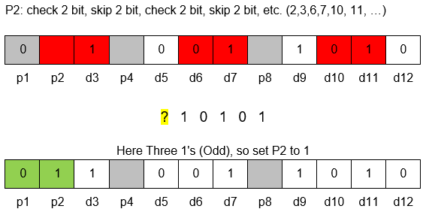
ERROR DETECTION AND CORRECTION

Slide 30
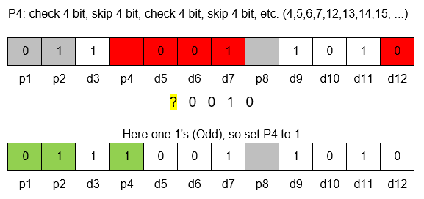
ERROR DETECTION AND CORRECTION

Slide 31
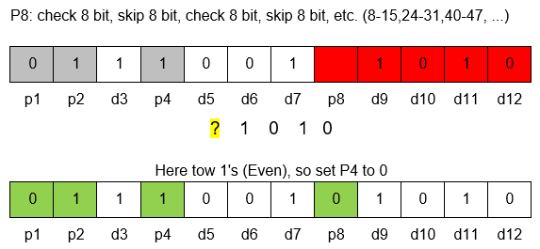
ERROR DETECTION AND CORRECTION
So, transmitted frame: 011100101010

Slide 32
ERROR DETECTION AND CORRECTION
For example, consider the following case will happen at receiver:
011100101110

Slide 33
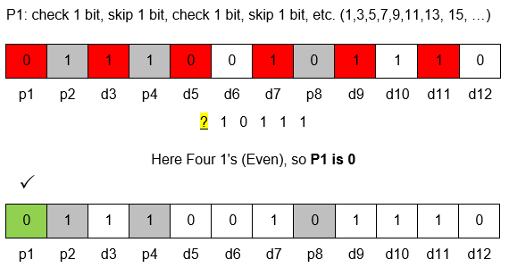
ERROR DETECTION AND CORRECTION

Slide 34
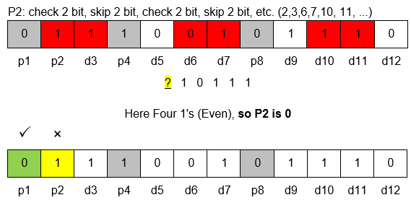
ERROR DETECTION AND CORRECTION

Slide 35
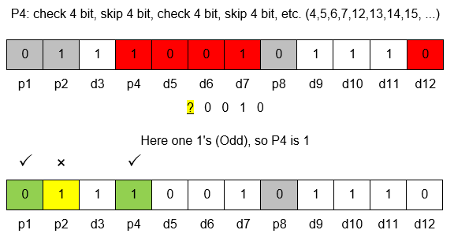
ERROR DETECTION AND CORRECTION

Slide 36
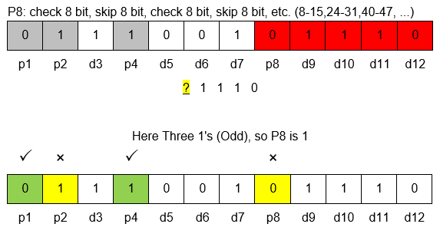
ERROR DETECTION AND CORRECTION

Slide 37
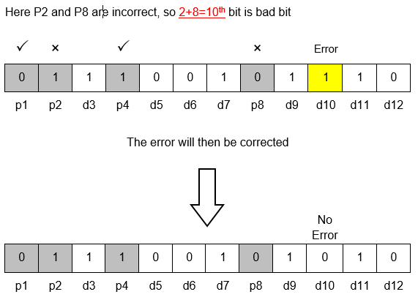
ERROR DETECTION AND CORRECTION

Slide 38
ERROR DETECTION AND CORRECTION
How to detect source errors?
In order ensure that the frames are delivered correctly, the receiver should inform the sender about incoming frames using positive or negative acknowledgements.
The types of acknowledgements:
Cumulative acknowledgements: A single acknowledgement to all the frames
Selective acknowledgements: Acknowledgement for a particular frame.
They may be also classified as:
Individual acknowledgements
Group acknowledgements

Slide 39
ERROR DETECTION AND CORRECTION
Piggybacking
Instead of sending ack frame on its own, if there is an outgoing data frame in the next short interval, attach the ack to it (using "ack" field in header).
Better use of bandwidth. Ack is only a few bits (here 1 bit). Costly to have to construct an entire frame for it.
If no data frame going out after timeout, just send ack frame on its own.

Slide 40
THANK YOU

